Slide 1
CT4029 Principles of Programming Day 3 – Session 5 SQLite Database in Python

Slide 2
Learning Outcomes
Understanding of databases
How to design a database
Assigning keys
Relationships
Querying databases
Interacting with databases using Python

Slide 3
Today’s Agenda!
Relational Databases
Create Read Update Delete
Databases in Python

Slide 4
DB Browser for SQLite

Slide 5
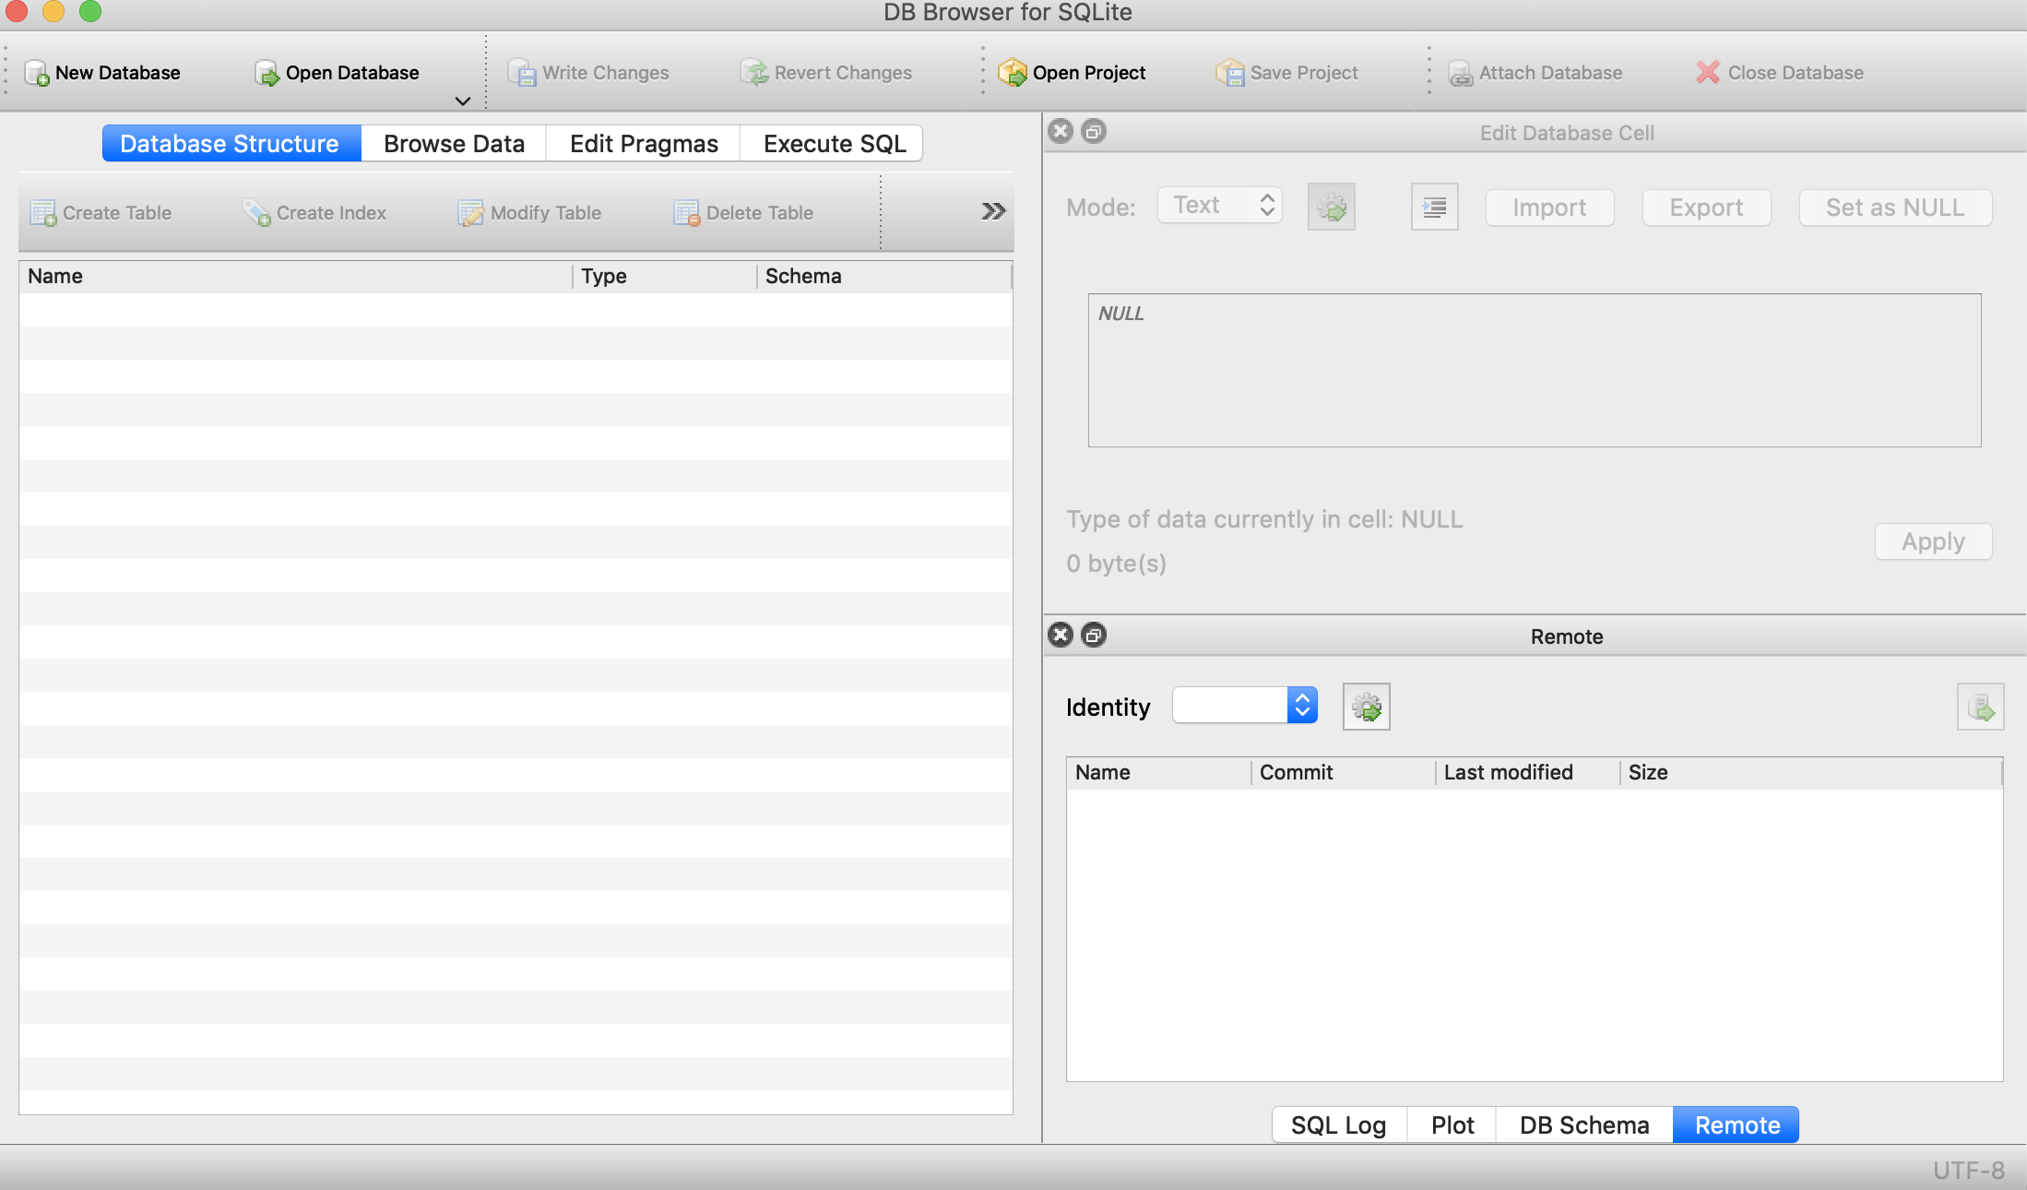
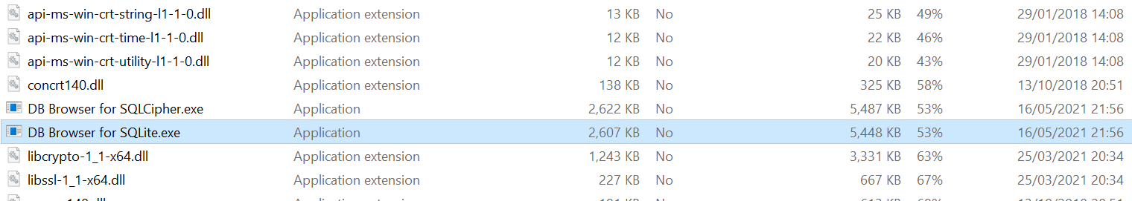
DB Browser for SQLite – Free Tool
https://sqlitebrowser.org/
https://sqlitebrowser.org/blog/version-3-12-2-released/
Please check Moodle Day 3 – Session 5 for the .zip file of DB Browser

Slide 6
Relational Database

Slide 7
Relational Databases
Relational databases model data by storing rows and columns in tables. The power of the relational database lies in its ability to efficiently retrieve data from those tables and in particular where there are multiple tables and the relationships between those tables involved in the query.
http://en.wikipedia.org/wiki/Relational_database

Slide 8
Terminology (1/3)
Database – contain tables
Relation (tables) – contains tuples and attributes
Tuple (or row) – a set of fields that generally represents an “object” like a person or a music track
Attribute (also column or field) – one of possibly many elements of data corresponding to the object represented by the row

Slide 9
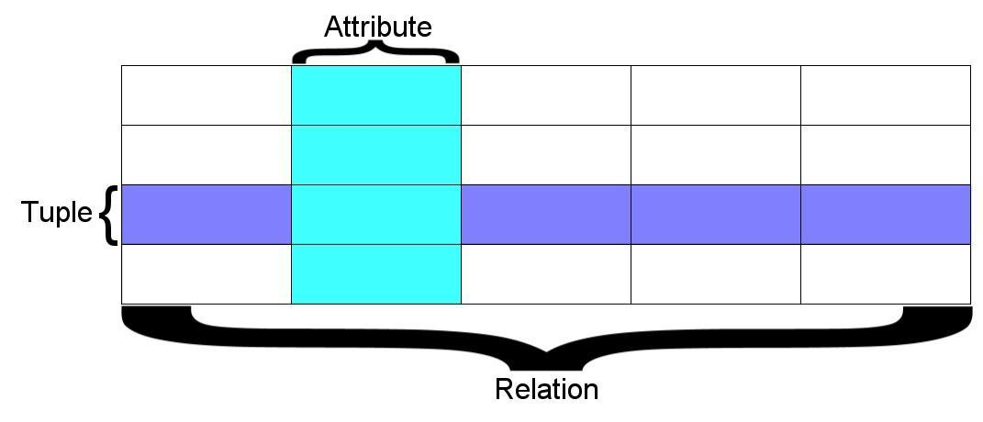
Terminology (2/3)
A relation is defined as a set of tuples that have the same attributes. A tuple usually represents an object and information about that object. Objects are typically physical objects or concepts. A relation is usually described as a table, which is organized into rows and columns. All the data referenced by an attribute are in the same domain and conform to the same constraints. (Wikipedia)

Slide 10
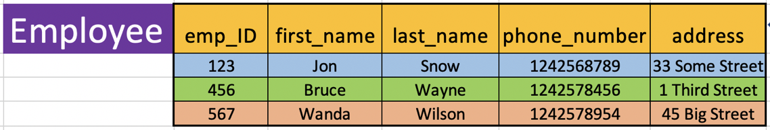
Terminology (3/3)
Table/Relation
Columns/ Attributes
Tuples/Rows

Slide 11
Two Roles in Large Projects
Application Developer:
Builds the logic for the application, the look and feel of the application
Monitors the application for problems
Database Administrator:
Monitors and adjusts the database as the program runs in production
Often both people participate in the building of the “Data model”

Slide 12
Database Model
A database model or database schema is the structure or format of a database, described in a formal language supported by the database management system, In other words, a “database model” is the application of a data model when used in conjunction with a database management system.
http://en.wikipedia.org/wiki/Database_model

Slide 13
Database Design
Database design is an art of its own with particular skills and experience
Our goal is to avoid the really bad mistakes and design clean and easily understandable databases
Others may performance tune things later
Database design starts with a picture...

Slide 14
Building a Data Model
Drawing a picture of the data objects for our application and then figuring out how to represent the objects and their relationships
Basic Rule: Don’t put the same string data in twice - use a relationship instead
When there is one thing in the “real world” there should be one copy of that thing in the database

Slide 15
Key Types
Primary Key – generally an integer auto-increment field
Logical key - What the outside world uses for lookup
Foreign key - generally an integer key pointing to a row in another table

Slide 16
Primary Key Rules
Best practices
Never use your logical key as the primary key
Logical keys can and do change, albeit slowly
Relationships that are based on matching string fields are less efficient than integers

Slide 17
Foreign Keys
A foreign key is when a table has a column that contains a key which points to the primary key of another table.
When all primary keys are integers, then all foreign keys are integers

Slide 18
Relationship Building (in tables)
Track
Artist
id
id
Album
title
name
id
rating
title
len
artist_id
Table
Primary key
Logical key
Foreign key
count
album_id
genre_id
Genre
id
Naming FK artist_id is a convention
name

Slide 19
Relationship Types: One-to-One (1/8)
You share many relationships with members of your family. For instance, you and your mother are related. You have only one mother, but she may have several children. You and your siblings are related—you may have many brothers and sisters and, of course, they'll have many brothers and sisters as well. If you're married, both you and your spouse have a spouse—each other—but only one at a time. Database relationships are very similar in that they're associations between tables. There are three types of relationships
One-to-One
One-to-Many
Many-to-Many

Slide 20
Relationship Types: One-to-One (2/8)
One-to-one: Both tables can have only one record on either side of the relationship. Each primary key value relates to only one (or no) record in the related table. They're like spouses—you may or may not be married, but if you are, both you and your spouse have only one spouse. Most one-to-one relationships are forced by business rules and don't flow naturally from the data. In the absence of such a rule, you can usually combine both tables into one table without breaking any normalization rules.

Slide 21
Relationship Types: One-to-Many (3/8)
One-to-many: The primary key table contains only one record that relates to none, one, or many records in the related table. This relationship is similar to the one between you and a parent. You have only one mother, but your mother may have several children.

Slide 22
Relationship Types: One-to-Many: Example (4/8)
Track
Review:
One to Many
belongs-to
Title
Album
Rating
One
Many
Len
Count
Track
Table
Primary key
Logical key
Foreign key
id
Album
title
One
id
rating
title
len
Many
count
album_id

Slide 23

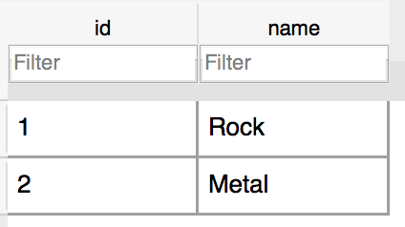
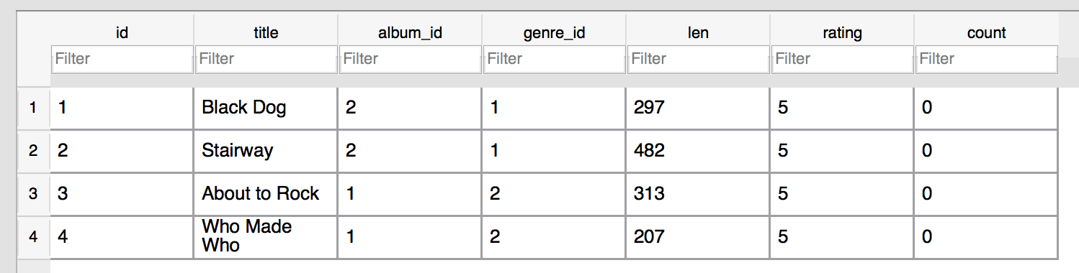
Relationship Types: One-to-Many: Example (5/8)
One
Many
One
Many

Slide 24
Relationship Types: Many-to-Many (6/8)
Many-to-many: Each record in both tables can relate to any number of records (or no records) in the other table. For instance, if you have several siblings, so do your siblings (have many siblings). Many-to-many relationships require a third table, known as an associate or linking table, because relational systems can't directly accommodate the relationship.

Slide 25

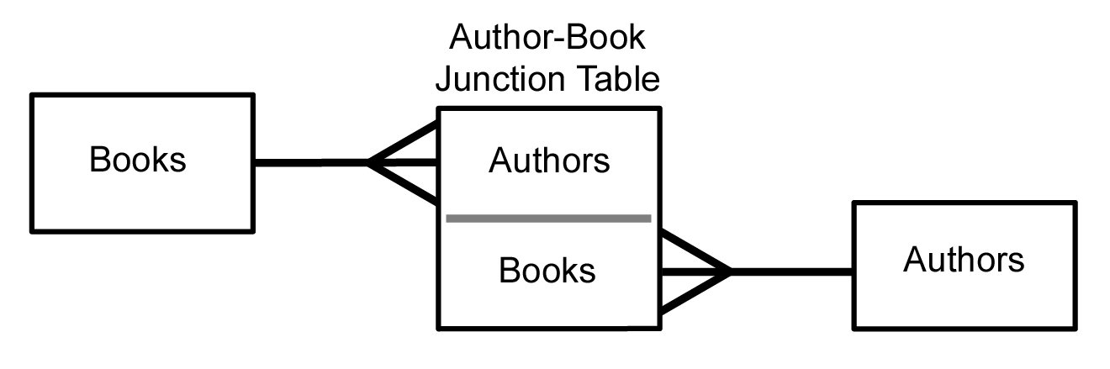
Relationship Types: Many-to-Many (7/8)
Sometimes we need to model a relationship that is many-to-many
We need to add a "connection" table with two foreign keys
There is usually no separate primary key

Slide 26
Relationship Types: Many-to-Many (8/8)
member-of
User
Course
title
name
Many
Many
email
User
Course
Member
id
id
Many
user_id
One
name
title
One
course_id
Many
email

Slide 27
SQLite – DB Browser

Slide 28
SQL
Structured Query Language is the language we use to issue commands to the database:
Create a table
Retrieve some data
Insert data
Delete data

Slide 29
SQLite Browser
SQLite is a very popular database - it is free and fast and small
SQLite Browser allows us to directly manipulate SQLite files
http://sqlitebrowser.org
SQLite is embedded in Python and a number of other languages

Slide 30
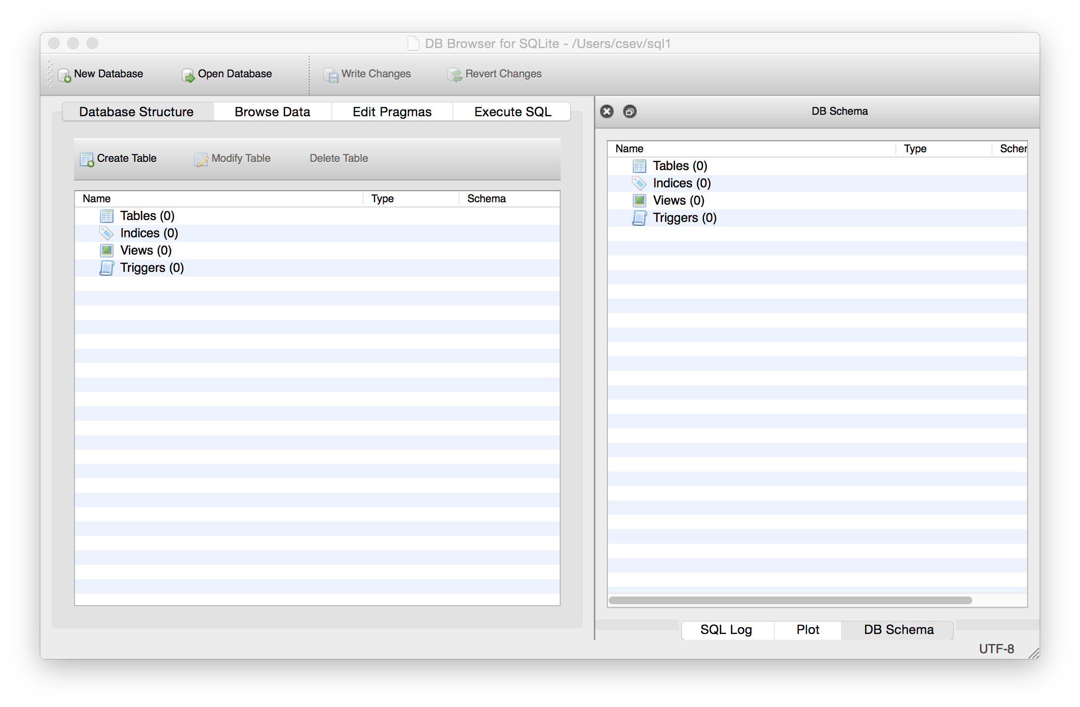
Text
http://sqlitebrowser.org/

Slide 31
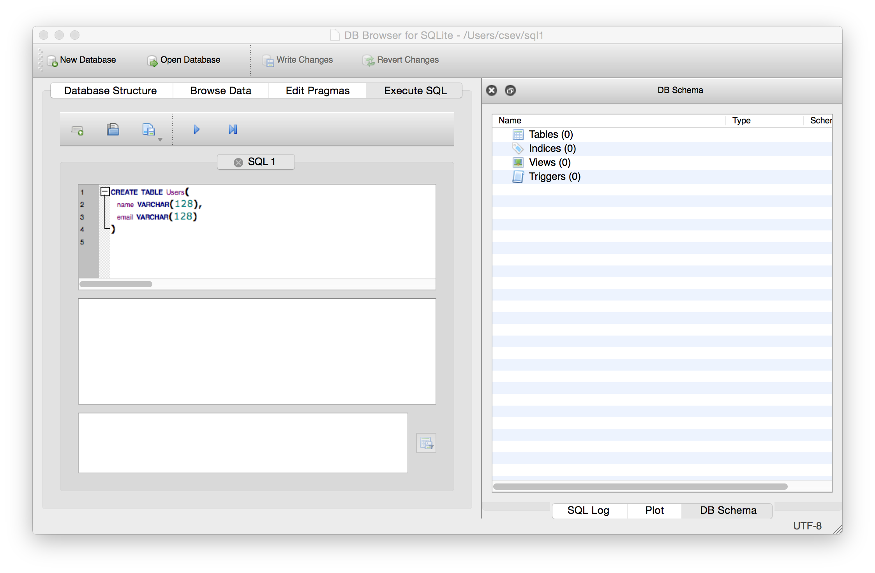
Start Simple - A Single Table
CREATE TABLE Users(
name TEXT,
email TEXT
)

Slide 32
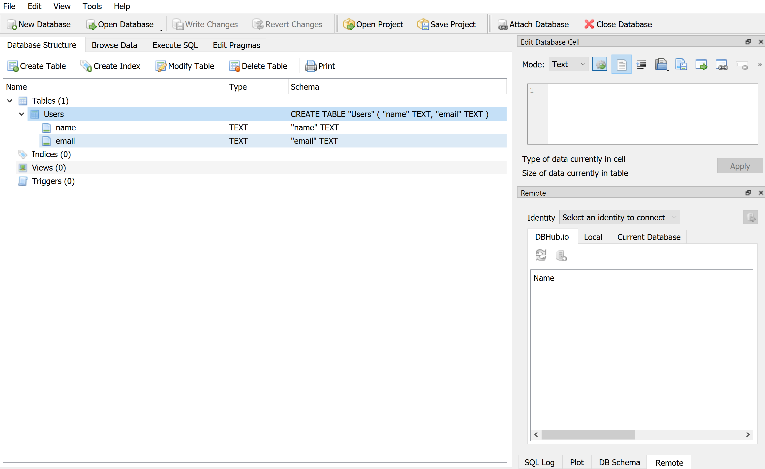
Start Simple - A Single Table

Slide 33
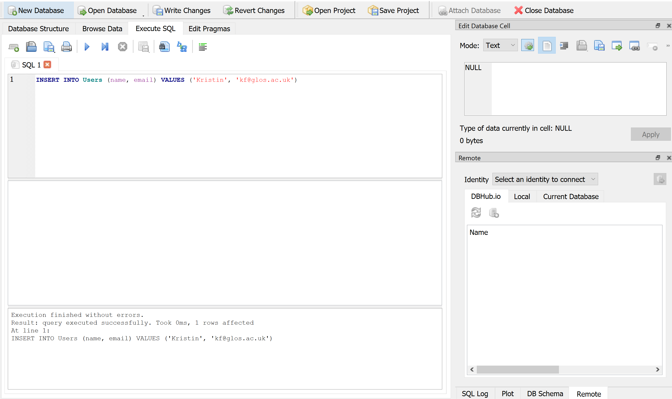
SQL Insert
The Insert statement inserts a row into a table:
INSERT INTO Users (name, email) VALUES ('Kristin', ‘kf@glos.ac.uk')

Slide 34
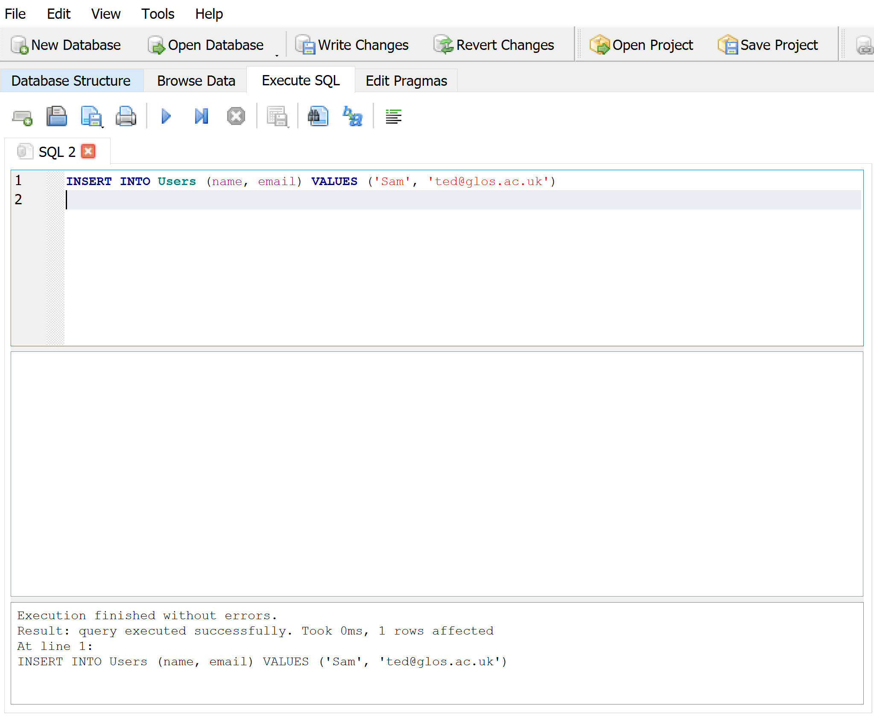
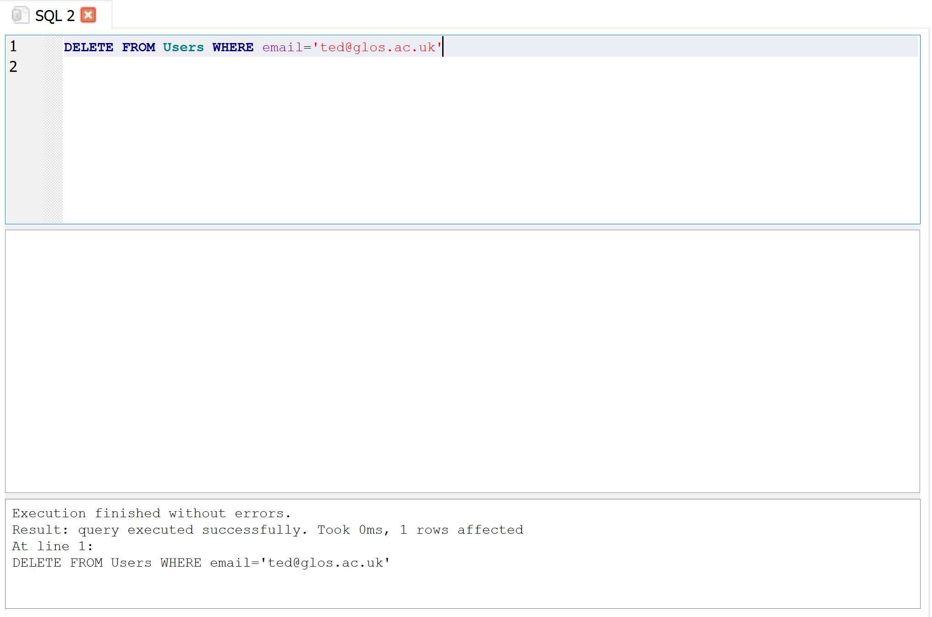
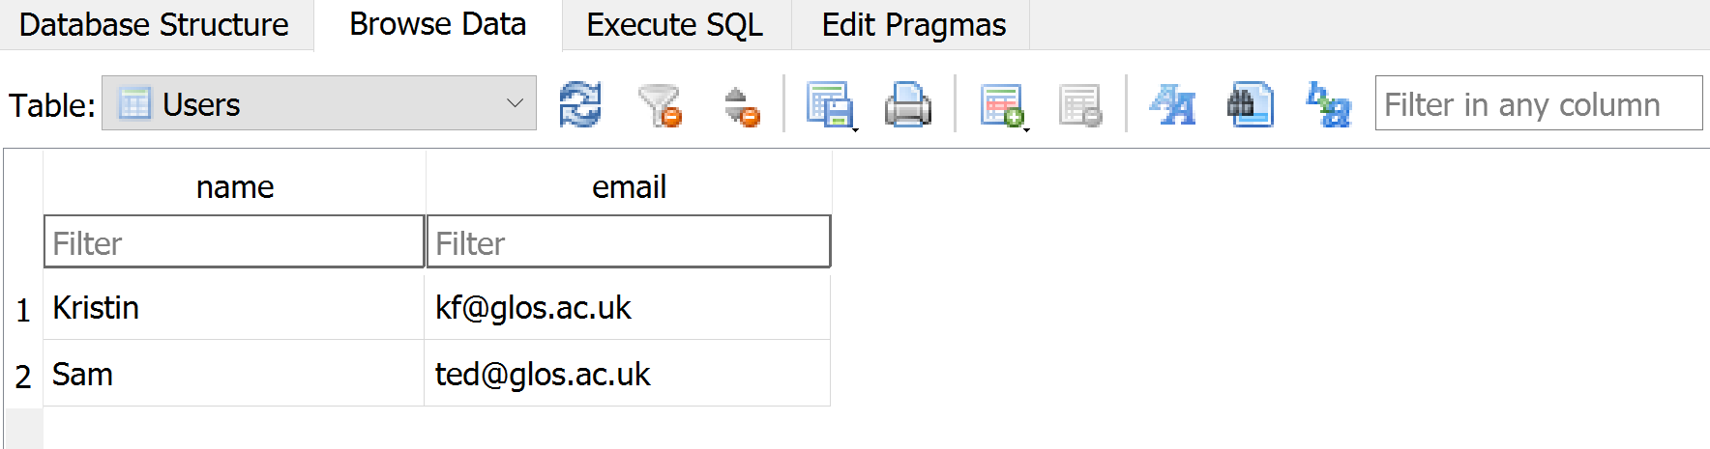
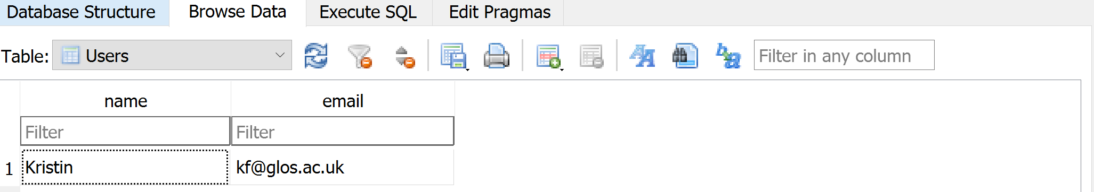
SQL Delete
Deletes a row in a table based on a selection criteria:
DELETE FROM Users WHERE email='ted@glos.ac.uk'

Slide 35
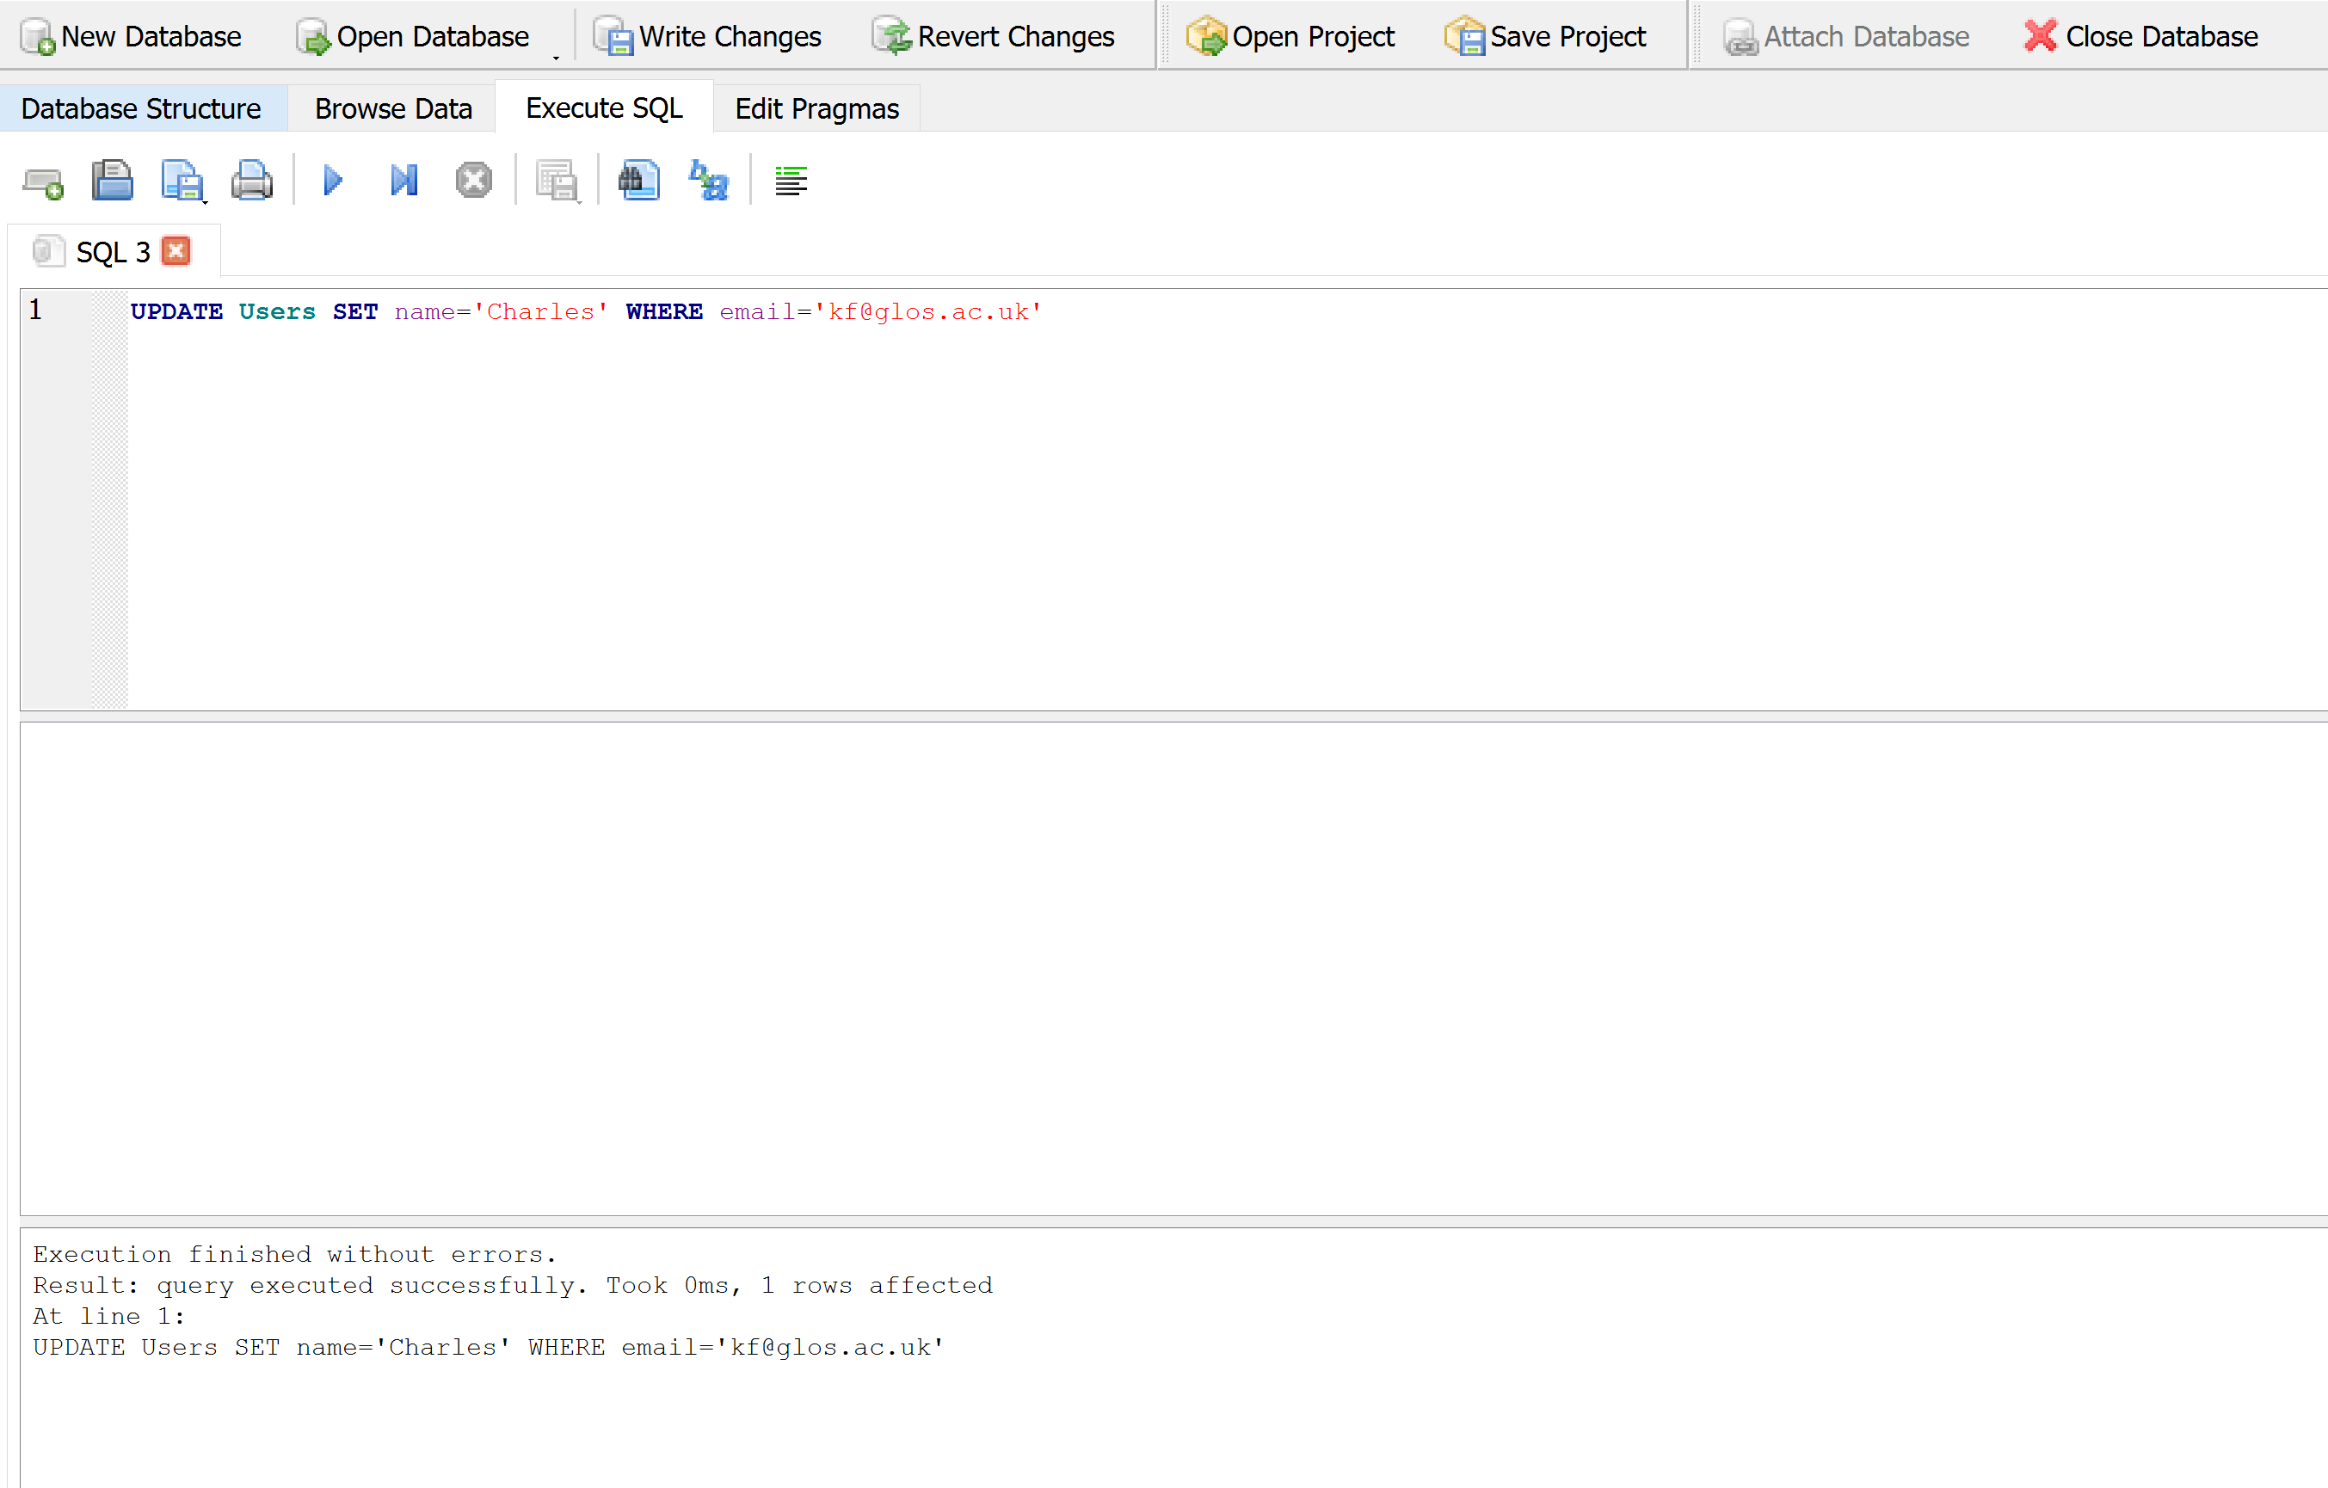
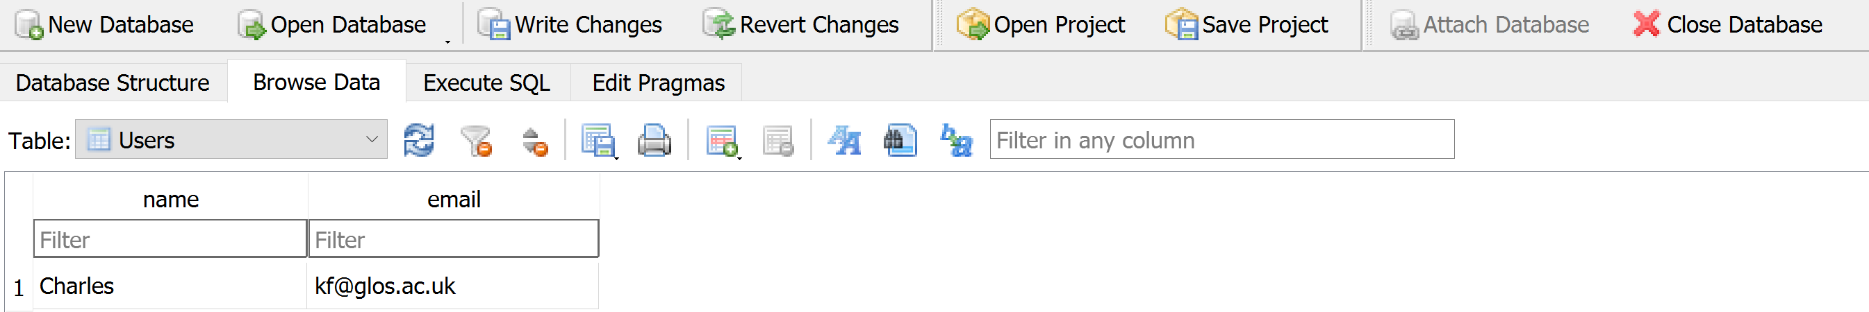
SQL Update
Allows the updating of a field with a where clause:
UPDATE Users SET name='Charles' WHERE email=‘kf@glos.ac.uk'

Slide 36
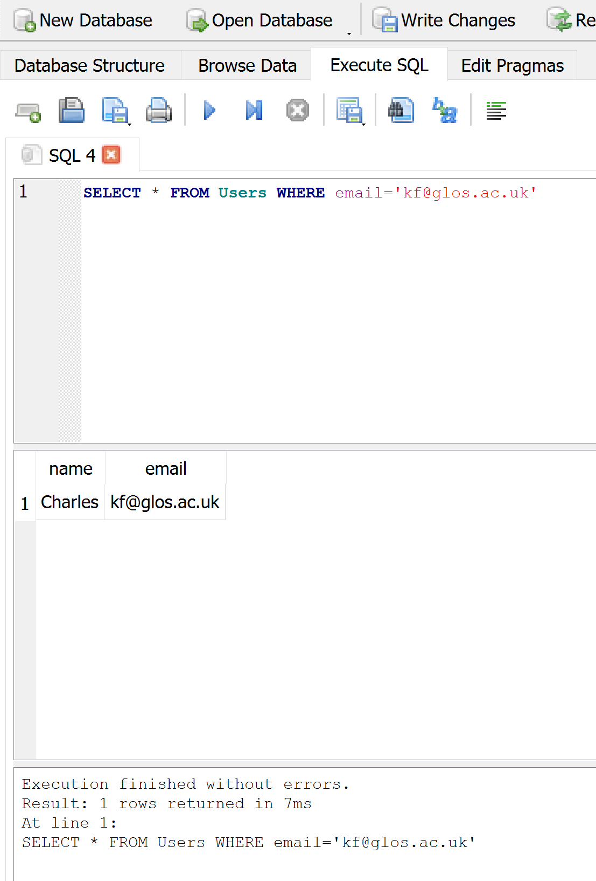
Retrieving Records: Select
The select statement retrieves a group of records - you can either retrieve all the records or a subset of the records with a WHERE clause:
SELECT * FROM Users
SELECT * FROM Users WHERE email='csev@glos.ac.uk'

Slide 37
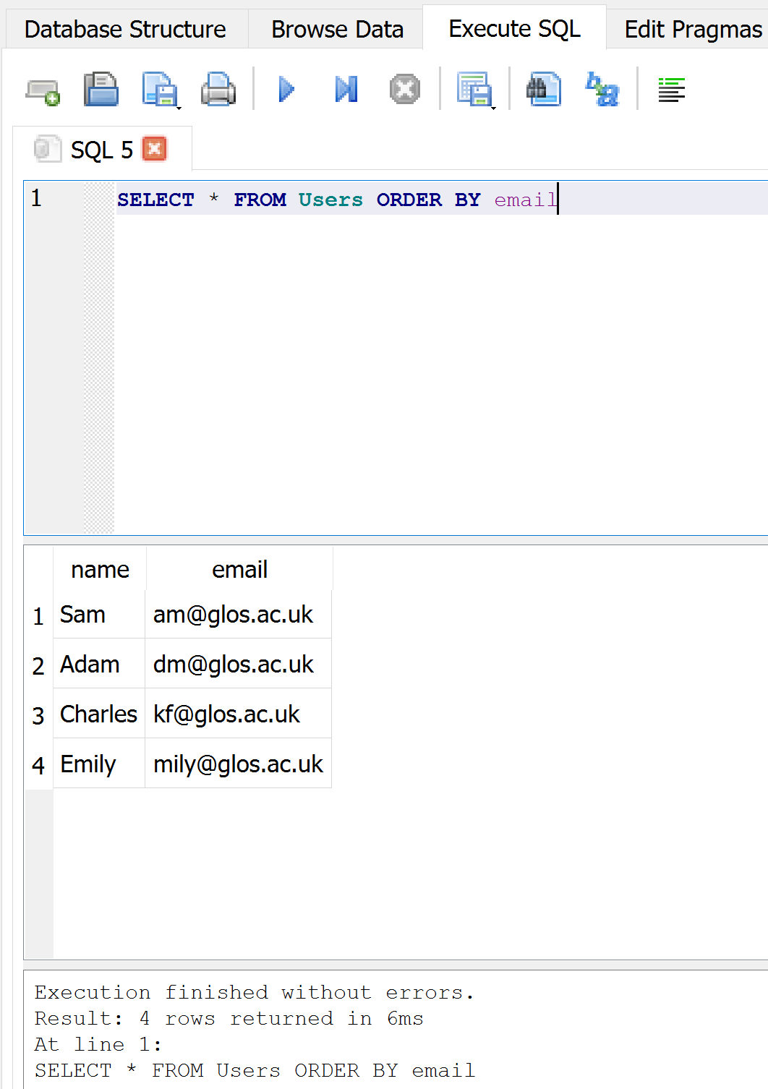
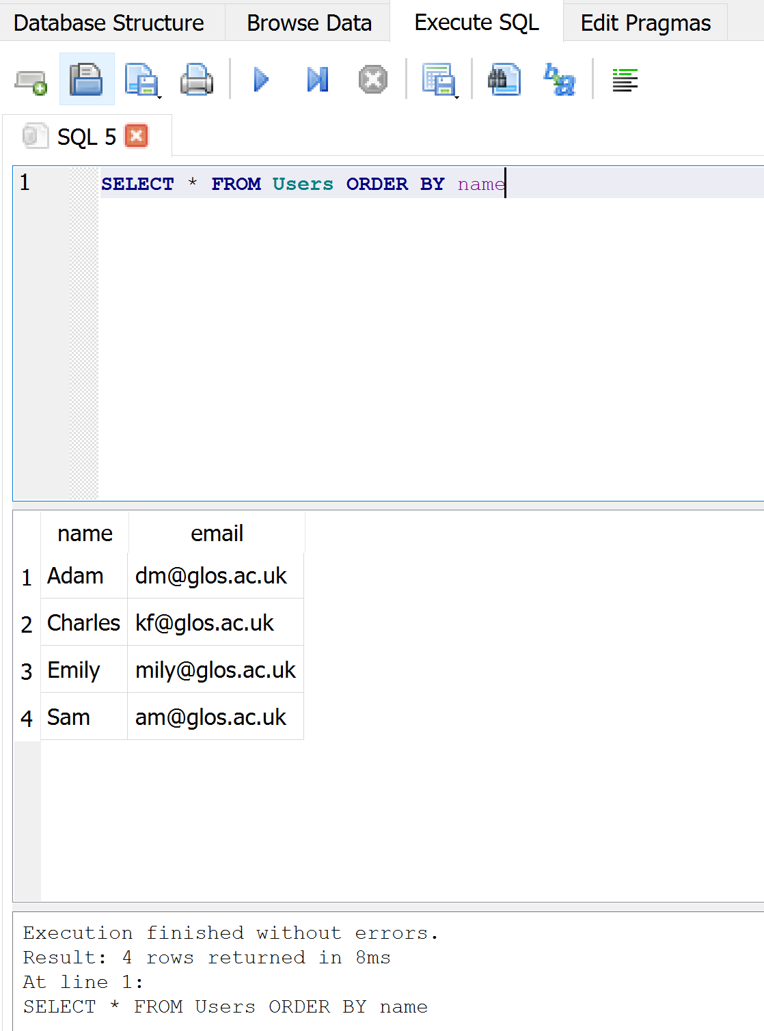
Sorting with ORDER BY
You can add an ORDER BY clause to SELECT statements to get the results sorted in ascending or descending order:
SELECT * FROM Users ORDER BY email
SELECT * FROM Users ORDER BY name

Slide 38
SQL Summary
INSERT INTO Users (name, email) VALUES ('Kristin', ‘kf@glos.ac.uk')
DELETE FROM Users WHERE email='ted@glos.ac.uk'
UPDATE Users SET name="Charles" WHERE email='csev@glos.ac.uk'
SELECT * FROM Users
SELECT * FROM Users WHERE email='csev@glos.ac.uk'
SELECT * FROM Users ORDER BY email

Slide 39
SQLite – Python

Slide 40
Error Handling With Exceptions
Exceptions are used to deal with extraordinary errors (‘exceptional ones’).
Typically these are fatal runtime errors (“crashes” program)
Example: trying to open a non-existent file
Basic structure of handling exceptions:
try:
Attempt something where exception error may happen
except <exception type>:
React to the error
else: # Not always needed (optional)
What to do if no error is encountered
finally: # Not always needed (optional)
The finally clause is optional. It is intended to define clean-up actions that must
be executed under all circumstances

Slide 41
SQLite in Python
Four things need to happen for Python to interact with SQLite
Import the sqlite module
import sqlite3
Connection to the database (or create one) with a given name
connection = sqlite3.connect(‘databasename.sql’)
Get a cursor to the database:
cursor = connection.cursor()
Execute queries on the cursor:
cursor.execute(‘SELECT * FROM .... ‘)

Slide 42
SQLite in Python
Once a query has been executed on the cursor, some data might be available, e.g. if you made a SELECT query
cursor.fetchone() will return one record at a time.
cursor.fetchall() will return all matching records at once in a Python list.
You have to test if the result is None before using it.
Don’t forget to call connection.commit() to commit the changes

Slide 43
SQLite in Python - Example
conn = sqlite3.connect(‘Payroll.db') c = conn.cursor() sql = ''' CREATE TABLE IF NOT EXISTS Employee ( id integer PRIMARY KEY, name text, salary real, mobilephone integer ) ''' c.execute(sql) conn.commit() conn.close()

Slide 44
SQLite in Python – Example (contd.)
def log(id, name, salary, mobilephone): ''' logs data in the database. id: number name: string salary: number, mobilephone: number ''' data = (id, name, salary, mobilephone) conn = sqlite3.connect(‘Payroll.db') c = conn.cursor() sql = 'INSERT INTO EMPLOYEE VALUES (?, ?, ?, ?)’ #? Works as a placeholder c.execute(sql, data) conn.commit() conn.close()

Slide 45
Summary
Database enable applications to store data in a persistent manner
Designing a database requires identification of columns and attributes
multiple tables in a single database are related using different types of relationships
SQL is a querying language that enable users to interact with databases

Slide 46
Next Session!
Data structures:
Tuples
Lists

Slide 47


